Slide 1
Game Development 2B
NavMeshes

Slide 2

What is a navmesh
A navigation mesh is a way to define the path a Unity object can move across
NavMeshes only work in 3D
Alternative to graph-based pathfinding
Visual pathfinding
Pathfinding is a crucial component of Game AI
Pathfinding can be integrated into AI in a meaningful way to create gameplay
Often partnered with State Machines

Slide 3
What is a navmesh
A navmesh is an invisible mesh asset that Unity generates automatically to approximate all walkable “floor”surfaces in the level
01
The navigation mesh itself contains no AI. It does not make anything walk.
02
The navigation mesh is a mathematical model that contains all the necessary data that allows AI units to successfully calculate and travel a path that avoids obstacles as and when required.
03
A single navigation mesh is generated for a given level
04

Slide 4
Creating a 3d navmesh of a 2d game
2D games don’t have NavMeshes, because it’s difficult or impossible to mark objects in an image as “wall” or “floor”
You could mark this individually, but that’s a lot of code
Porting a 3D NavMesh to 2D is just an extra step after creating a 3D NavMesh

Slide 5
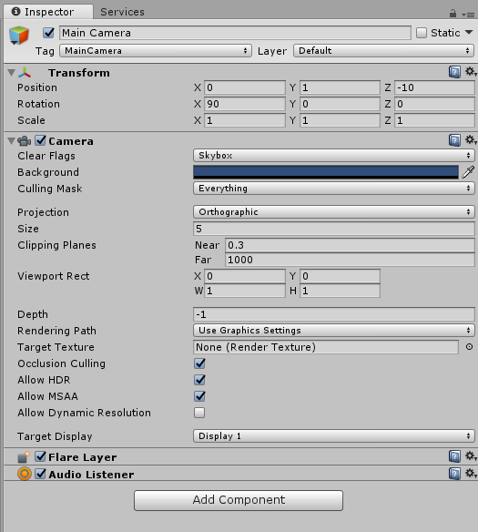
Setting up the unity project
New 3D Unity Project
Rotate camera X 90 degrees – allows for top down view
Orthographic perspective – just like in 2D – no depth
Because of camera rotation, we need to rotate our sprites 90 degrees as well

Slide 6
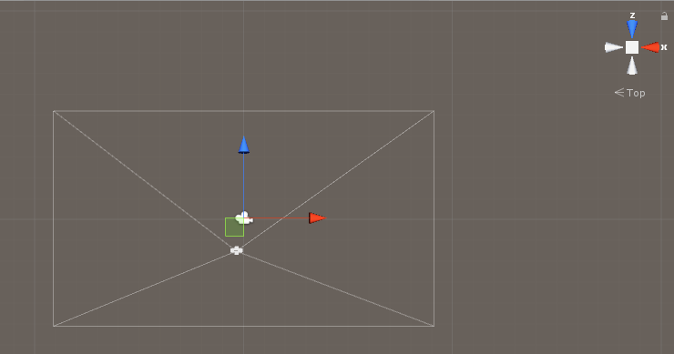
Changing camera perspective
Change the perspective to top view by clicking on the navwheel

Slide 7
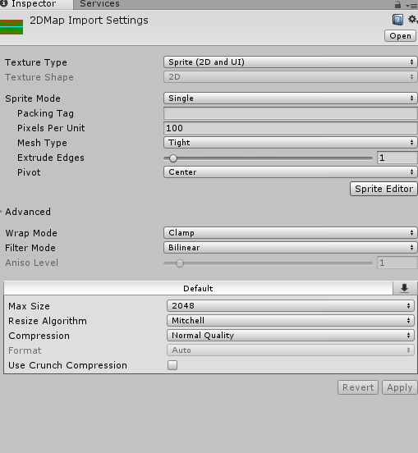
Importing assets
Same as usual
Must change all 2D sprites to 2D Sprite and UI (Unity 3D Default is texture)

Slide 8
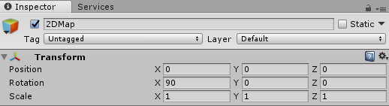
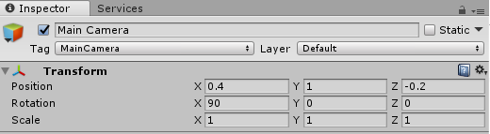
Building the scene
Drag into scene and rotate
Make sure your map is 0, 0, 0 centred. We’ll move our camera over our map
We’ll need to fix the camera location to make the scene viewable
Sorting layer for this perspective is the Y axis
Thus, the Y of our camera should always be some large value e.g. 100 so we can have enough sorting layers

Slide 9
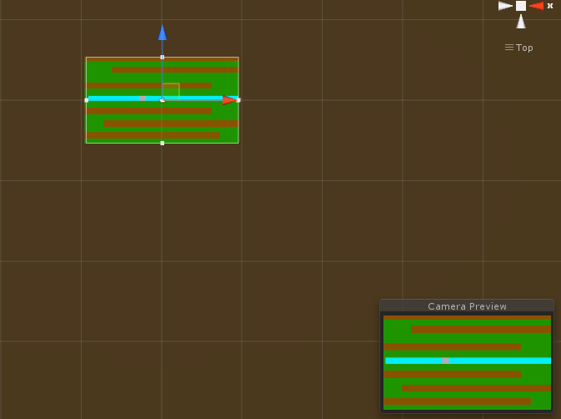
Building the scene

Slide 10
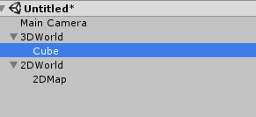
Ordering and building the 3d world
Put our 2D map and 3D map in separate compound objects
Create 3D objects inside the 3D map object and stretch them to create “walls”
Rather overestimate your walls than underestimate
It’s better to have invisible walls than clipping
We’ll do paths later

Slide 11
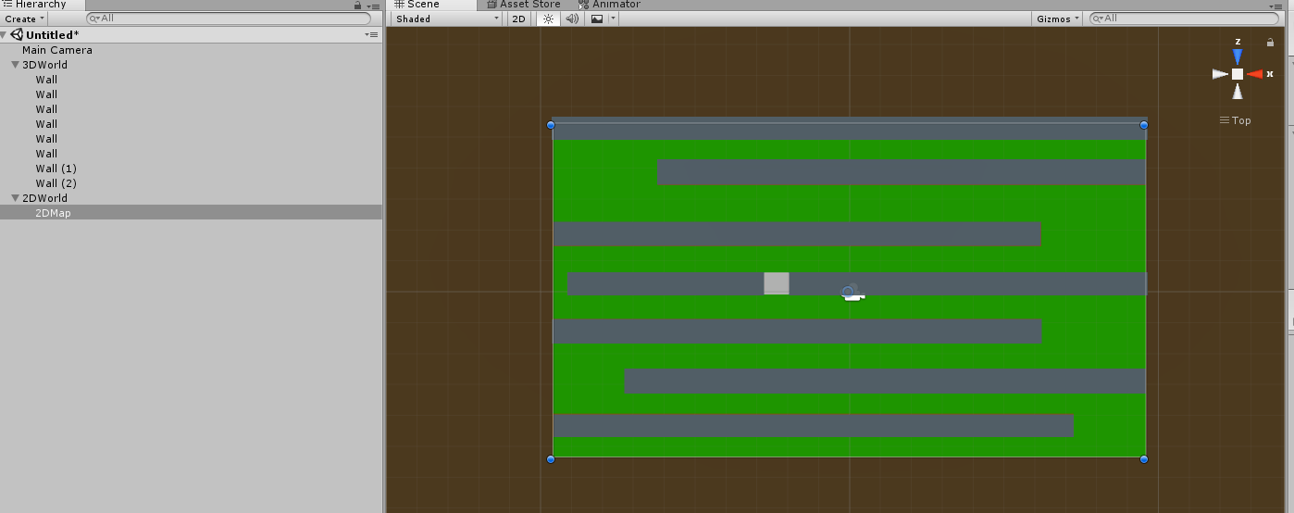
Building the 3d world

Slide 12
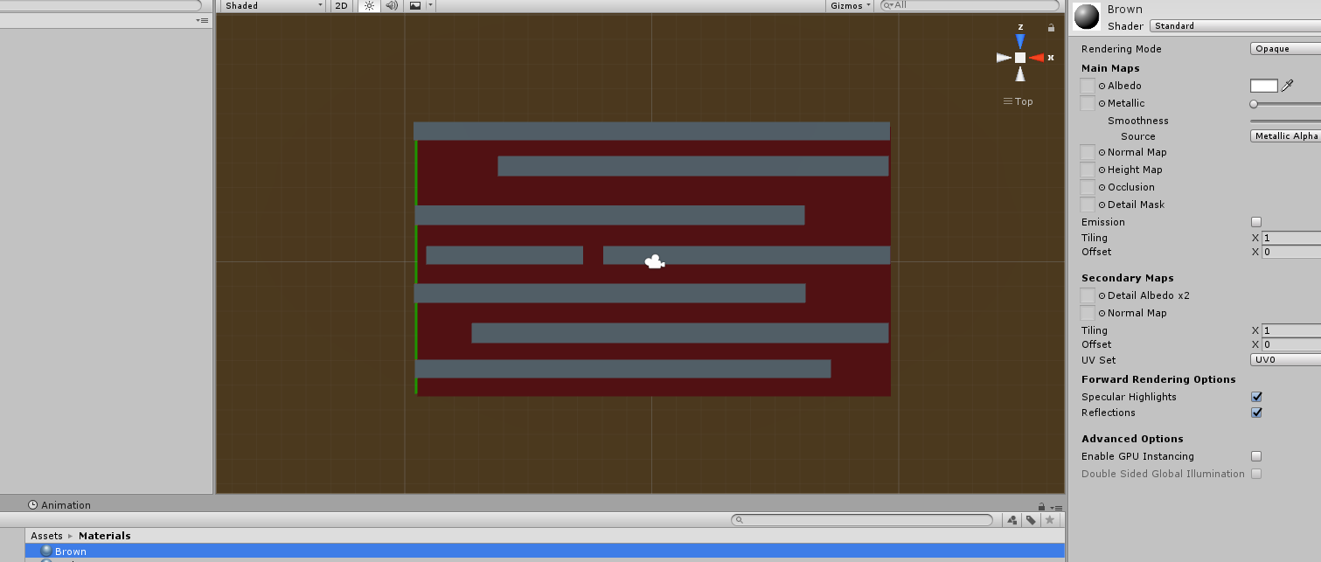
Creating the ground
A Plane 3D object
Rotate -90 degrees and stretch
Create new material to give it a background colour, select and drag on
Right Click in Assets – Create Material – Give Colour

Slide 13
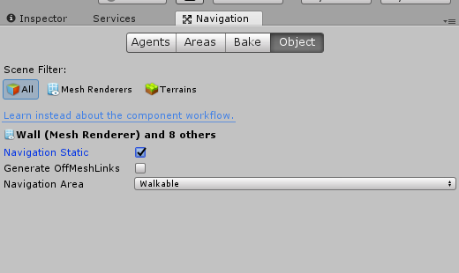
Creating the mesh
Navigation Window
Select all objects and, in the object tab, mark as Navigation Static
This includes the object in the mesh
You’ll notice everything is Walkable
Select all the Walls and change to Not Walkable

Slide 14
Baking the Navigation mesh
This generates a mesh for the given object set
1
Radius: how big the radius around the object allowing for traversal
2
Agent height: the height of an agent – the smaller, the more it can fit into ceilinged spaces for example
3
Slope: Any object at a greater angle than this is treated as a wall
4
Step height: allows for the creation of steps and the ability to “move up stairs”
5

Slide 15
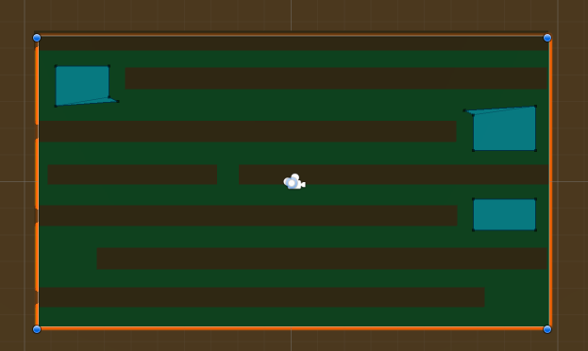
Baking the mesh
Press Bake
If the scene is weird, play around with radius and height until traversable space looks correct
Whenever you move the objects you need to rebake the mesh

Slide 16
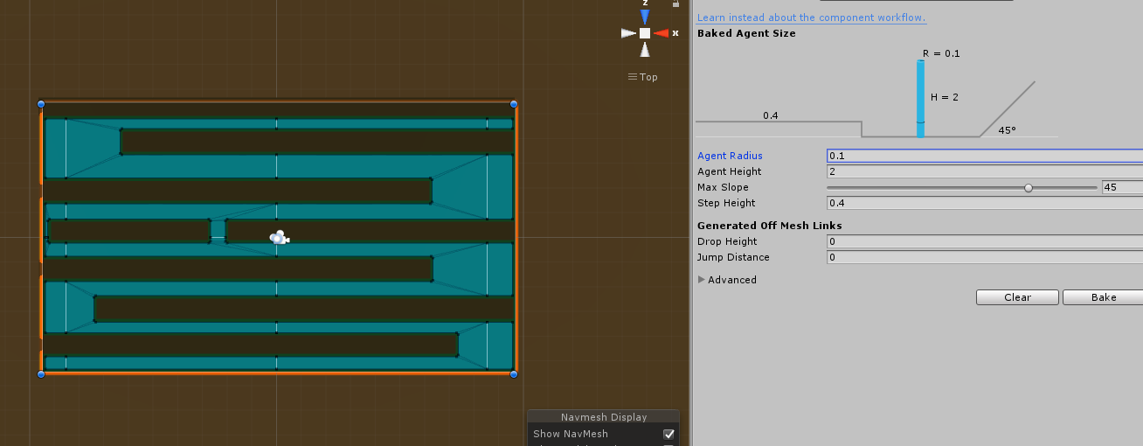
Traversable mesh

Slide 17
Creating the agent that traverses the mesh
Create
Create a cube in our 3D world
Place
Place it
Add
Add a NavMesh Agent component

Slide 18
Nav mesh agent settings
Radius
If two agents meet, radius determines how they move around each other
Speed and Acceleration
Determines speed and movement of agent
Angular speed
How tightly can the agent turn
Stopping distance
How far from target the agent starts to slow
Auto repath
Allows the agent to find another way around if blocked

Slide 19
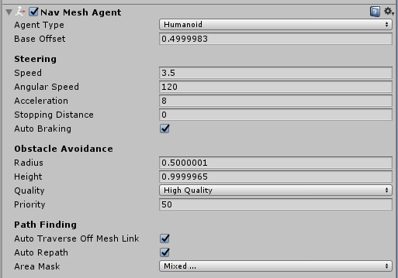
Nav mesh agent settings

Slide 20
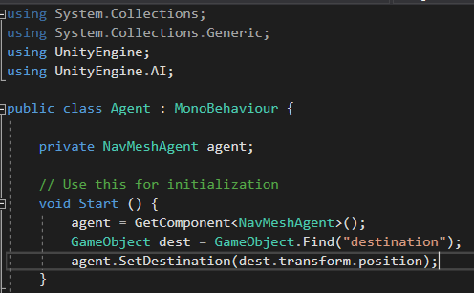
The navmesh agent script
Note: Using UnityEngine.AI;
You can set a concrete destination and have it move to the destination
This obviously has no user interaction

Slide 21
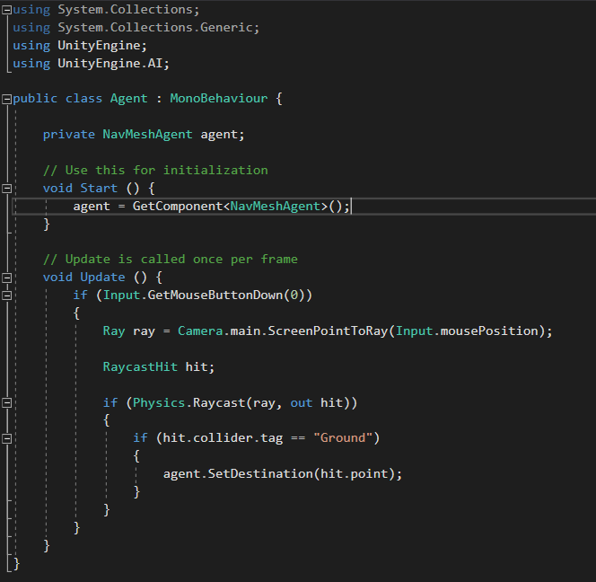
Adding mouse clicks
We need to change our Ground Plane’s tag to Ground
When we click somewhere with the mouse that’s ground, we move to it via the shortest path
Raycasting just helps us find where we’ve clicked in the world

Slide 22
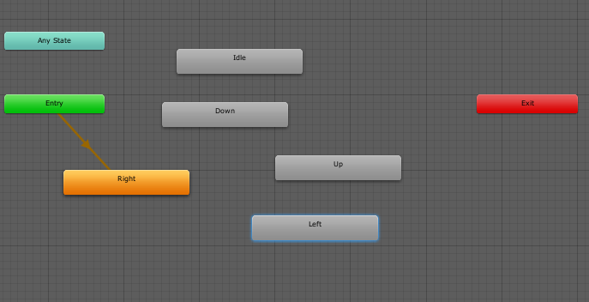
Adding the 2d layer
Make the animations for Idle, Up, Down, Left and Right
Put them in a single controller
Set Idle to default
This is all usual

Slide 23
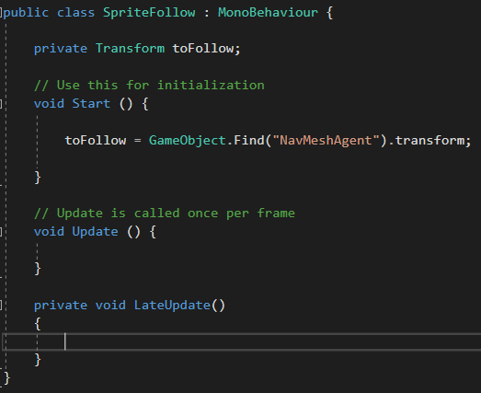
Writing the follower script
Have the script fetch the agent
Work in LateUpdate() as this will run after the NavMeshAgent’s Update()

Slide 24
lateupdate
We bind it to out follow’s X and Y but NOT Z
We may need an X or Y offset so the positioning stays consistent with our agent when it moves

Slide 25
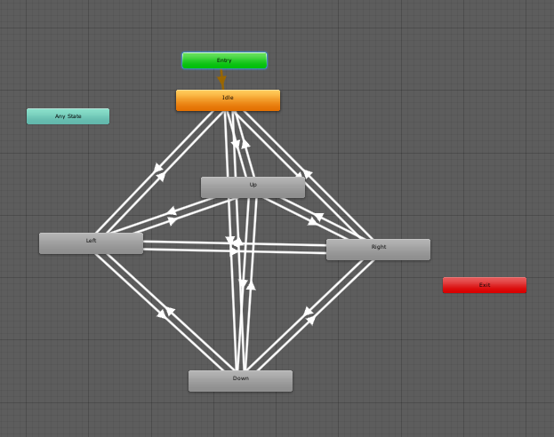
Animation state machine
Int Direction parameter that is 1-4
All states must go to all other states
Everything goes back to standard idle

Slide 26
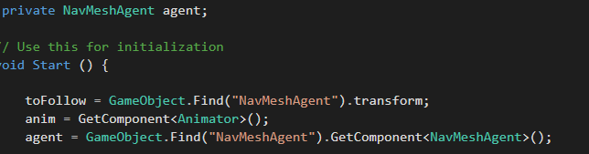
Linking the animation
Get Animator Component
Trigger animations based on NavMeshAgent Movement
Up: Velocity.z > 0
Down: z < 0
Right: x > 0
Left x < 0
Z instead of Y because our agent rotates when we move up/down

Slide 27
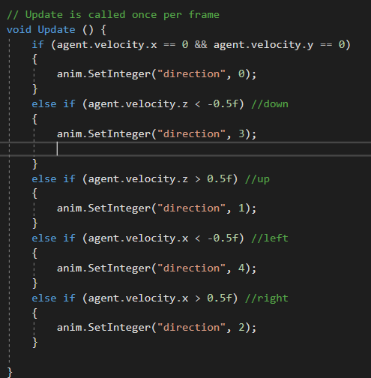
Changing our animation states
Use a float to allow for some discrepancy in moving in multiple directions
Here 0.5
Negative for down/left, positive for up/right as
This is how the X and Z will change in-game

